Slide 1

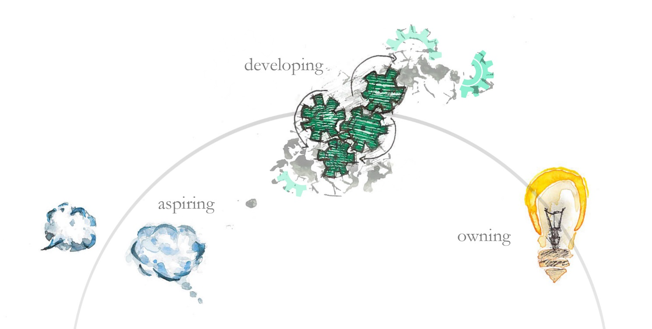
Edinburgh Award Leaders’ Meeting

Slide 2
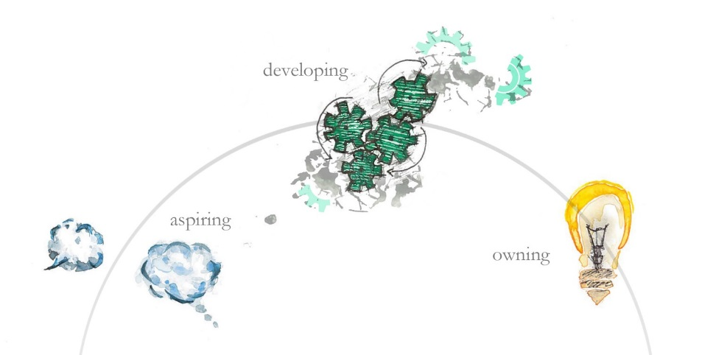
Agenda for the morning
Last year and the coming year
‘Selling’ at Input 3 and the Careers Service
Time to share – small groups
Key takeaways
Q&A

Slide 3
Last year
Around 1000 students achieved an Edinburgh Award across
68 different activities.
With 32 staff members running versions of the Award.
98% of students who responded to our survey said they felt better off as a result of the Award and would recommend it to a friend.
92% of students who said they started the Award for the recognition reported wider benefits.

Slide 4
Enhancement for this year
Flexible approach
  An Award can be run, or an individual student can undertake it, over up to 2 years.
  This is an option for Award Leaders not a requirement.
Notes:
One enhancement that we have been making plans around and that is to offer a more flexible approach to the length of time over which an Award can run.
We discussed with the Advisory Group where they might be willing to flex the Award requirements and while they decided there wasn’t any wiggle room on the number of learning hours we require or on the need for ongoing reflection, that where there could be flexibility would be in the length of time over which a student could complete the Award.
Currently an Award can run at most over a 12 month period but with our new offering an Award will be able to be run over a 2 year period or an individual student on an Award will be able to complete it over a 2 year period.
In the first scenario where an entire Award runs over a longer time period, all the students on that Award would complete it over this protracted tine period. The three inputs would be required and would still need to be spaced out evenly. During this time as well as the required Inputs we would also require touchpoints, whereby students submit reflections on their development so far – these reflections would be shorter than those required at Inputs 2 and 3. This does of course require the activity to continue over that time period and for the students to continue with the activity but there can be gaps where the activity isn’t taking place i.e over summer but reflection on development is still required.
In the second scenario a particular student or group of students can continue with the Award over a protracted period, again they still have to complete the Inputs and will require touchpoints but this does mean that if a student’s activity stops for whatever reason, there is the breathing space they might need to find another activity in order that they can continue the Award. So that means if we think about a typical Award timescale of October to March, a student could begin the Award in October and then not complete their Input 3 until 17 months later.
This is an option, certainly not something we are saying you have to implement. But if an issue for your Award is students not being able to amass the required learning hours then it may be something you want to consider and if so then just get in touch with me.

Slide 5
Input 3 – Careers Service support
Notes:
Up until now the option has been given for Award Leaders to request a Careers Consultant to come along and facilitate the ‘selling’ part at Input 3, while responsibility for all other parts of Input 3 belong to the Award Leaders, this can feel like a natural place to draw on the support and resources of the Careers Service.
Due to the resource this requires from the Careers Service there will be changes to the way they support this part of Input 3 going forwards. Lizzie Mortimer from the Careers Service came along to the session to talk through what that would look like.

Slide 6
Careers Service support for Edinburgh Award Leaders
Lizzie Mortimer
Assistant Director, Careers Service

Slide 7
Careers Service context
Careers Service very keen to work with and support Award Leaders
Endeavour to meet requests to support delivery, typically at Input 3
Capacity and logistics making this increasingly challenging
Now planning two options for Award Leaders.

Slide 8

Recorded input
‘Virtual’ Delivery
Piloted with two Edinburgh Awards in 2018-19
15 mins video, plus notes and handouts for Award Leader
Option for Award Leaders in 19-20

Slide 9
Award Leader Training Session
Planned session in early 2020 to enable Award Leaders to feel confident in running an input on CVs and Interviews
We’ll be seeking input from all Award Leaders on what support would be valuable
Aims: to facilitate positive student experience through delivery tailored to their context, to upskill Award leaders, reduce admin time across the board

Slide 10
Any questions / comments?
Elizabeth.mortimer@ed.ac.uk
0131 651 1581

Slide 11
Share in small groups
Get into groups discuss any aspect of your Award that you want to, each person has around 8-10 minutes to share and get feedback.

Slide 12
Feedback and Questions
Share one or two highlights from your conversations

